Slide 1

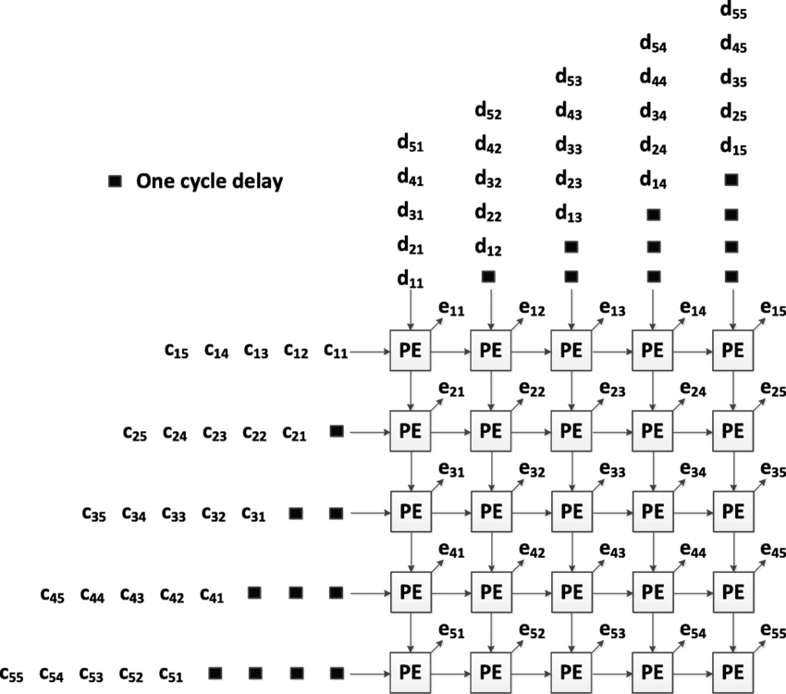
SYSTOLIC
ARRAYS
Page 01

Slide 2
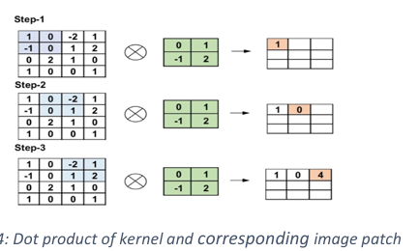
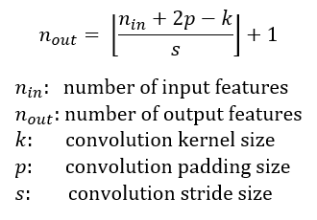
2D CONVOLUTION
Page 02

Slide 3
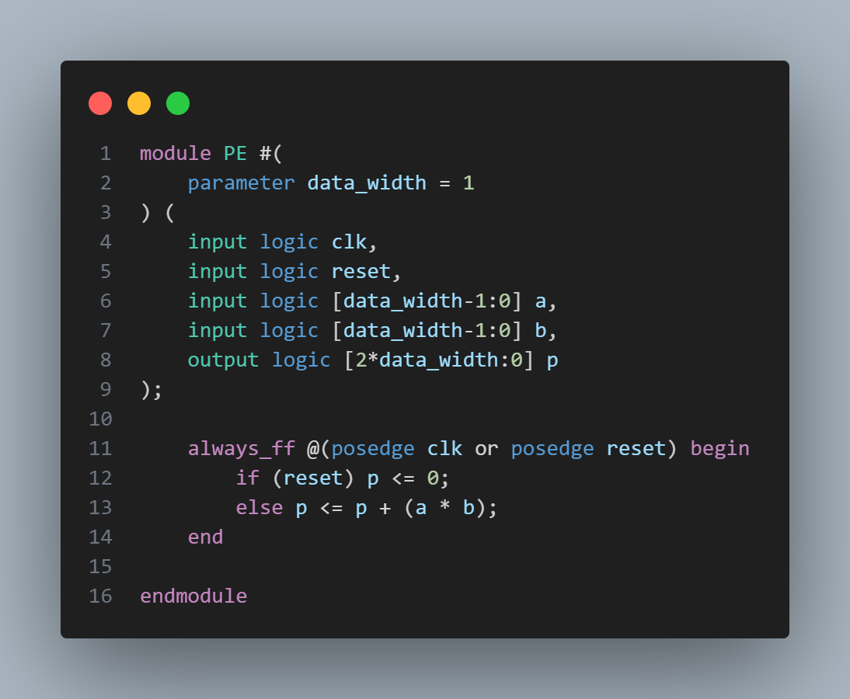
PE IMPLEMENTATION
Page 03

Slide 4
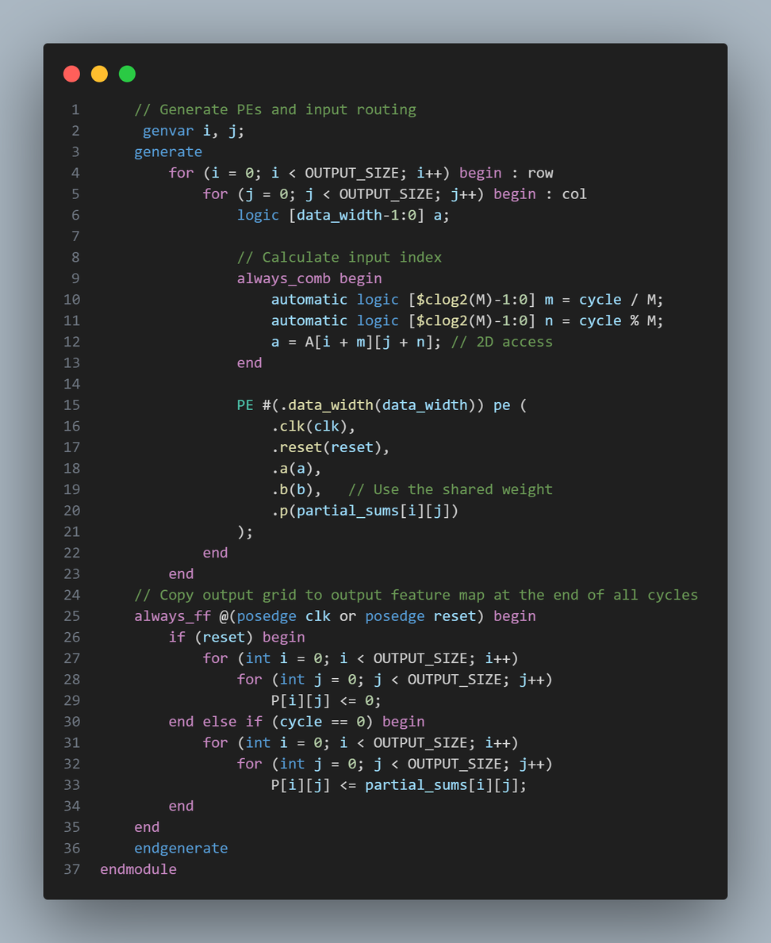
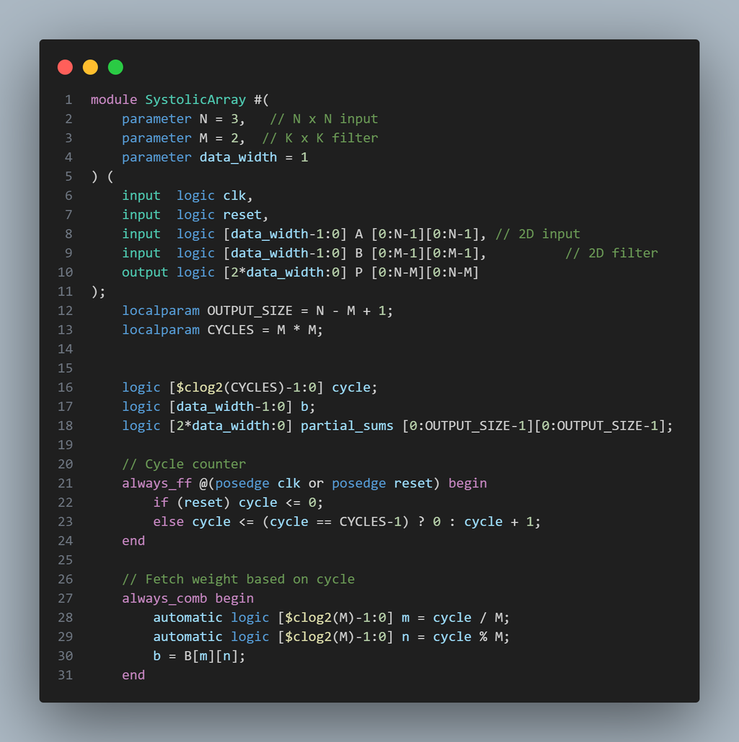
SYSTOLIC ARRAY
Page 04

Slide 5
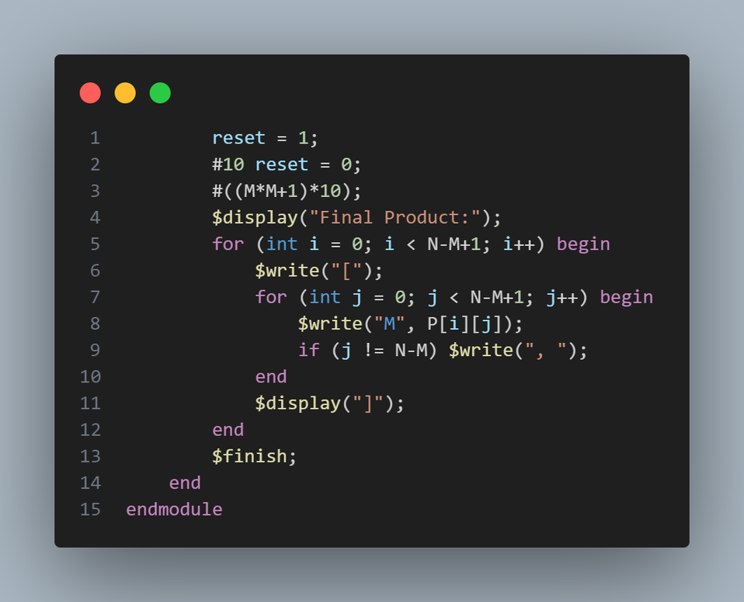
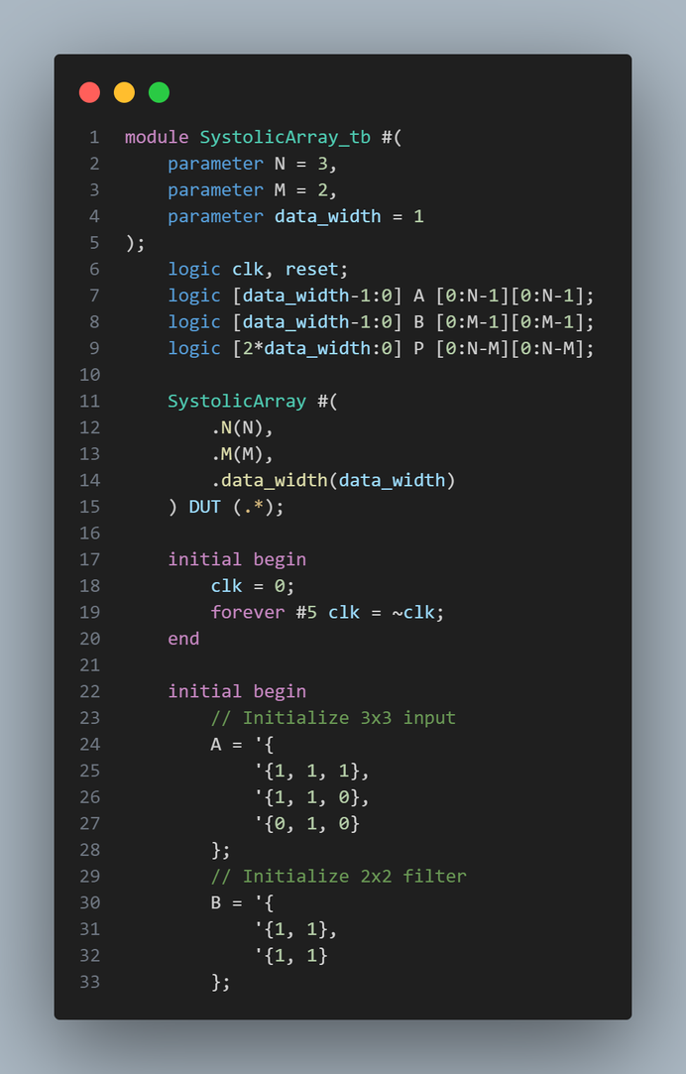
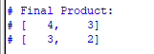
TESTBENCH
Page 05

Slide 6
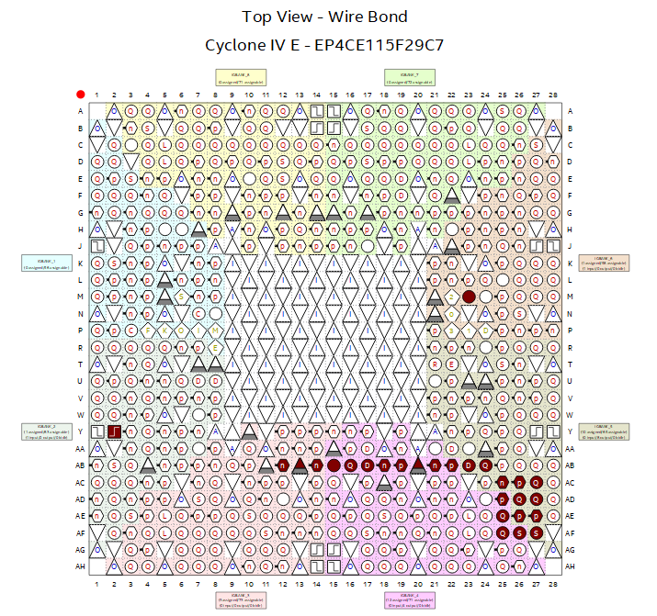
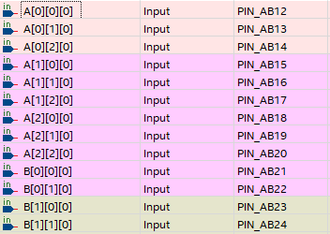
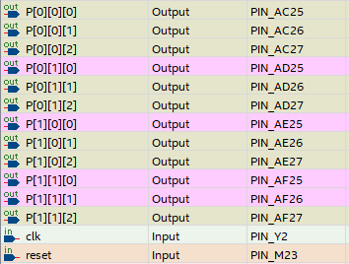
PIN ASSIGNMENT
Page 06

Slide 7
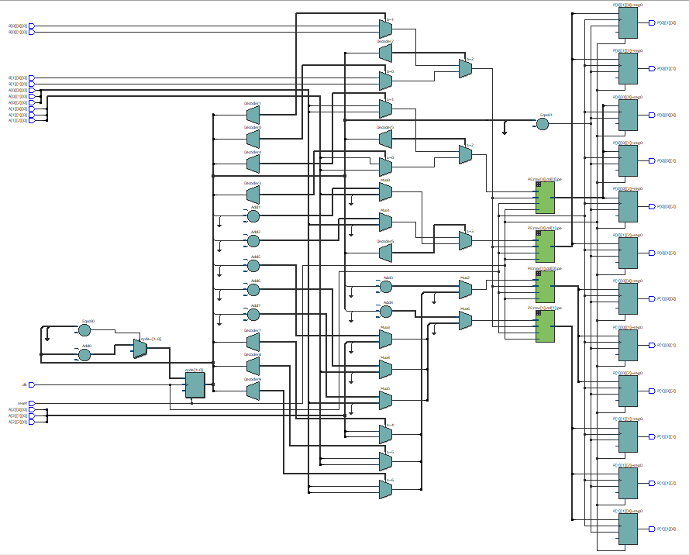
RTL
Page 07

Slide 8
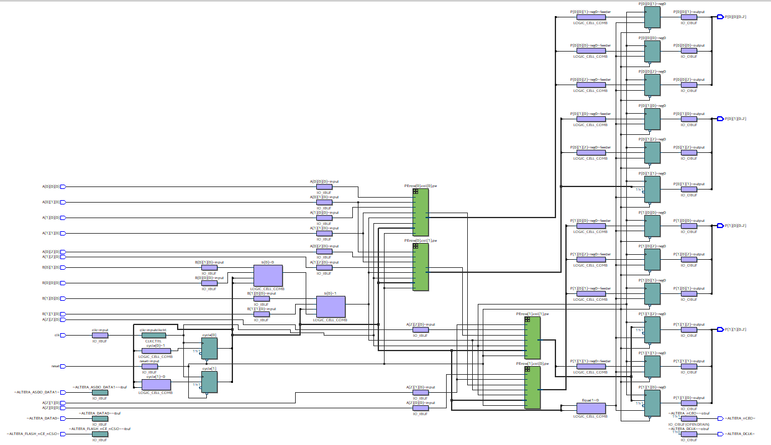
TECHNOLOGY MAP VIEWER
POST-FITTING
Page 08

Slide 9
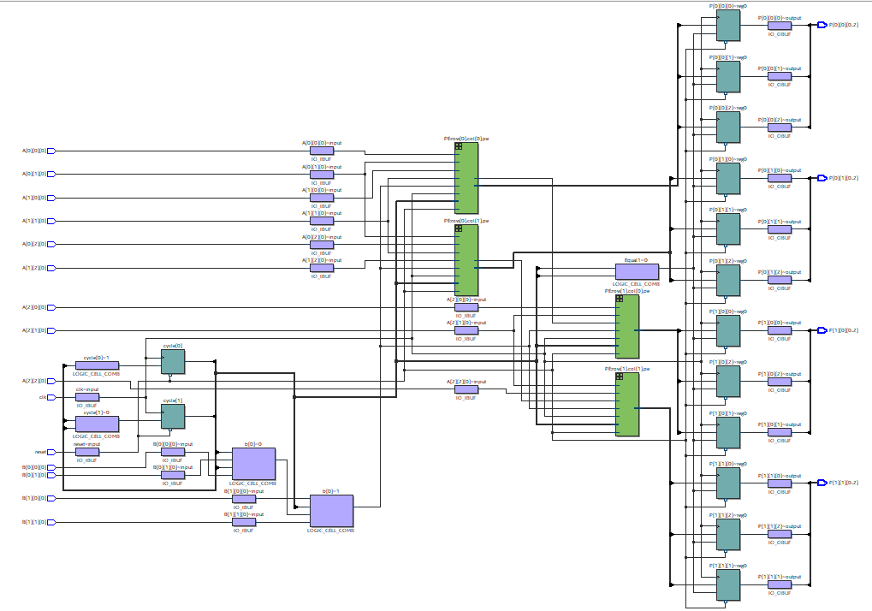
TECHNOLOGY MAP VIEWER
POST-MAPPING
Page 09

Slide 10
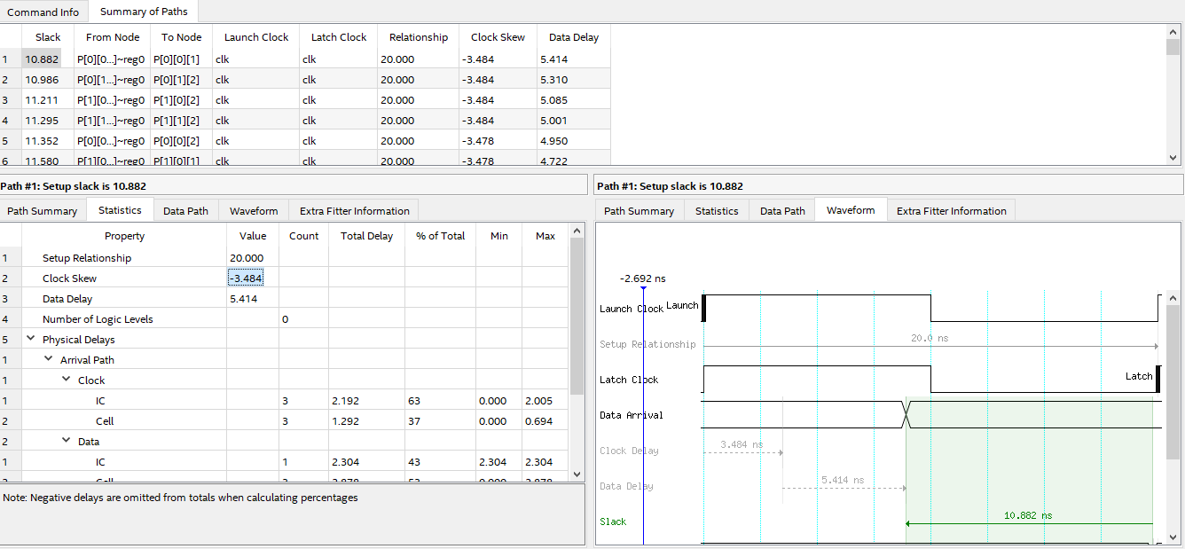
TIME ANALYIS
Page103

Slide 11
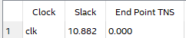
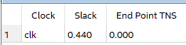
TIME ANALYIS
CREATE_CLOCK -NAME CLK -PERIOD 20.000
SET_INPUT_DELAY -CLOCK { CLK } 0.2 [GET_PORTS {A[0][0][0] A[0][1][0] A[0][2][0] A[1][0][0] A[1][1][0] A[1][2][0] A[2][0][0] A[2][1][0] A[2][2][0] B[0][0][0] B[0][1][0] B[1][0][0] B[1][1][0]}]
SET_OUTPUT_DELAY -CLOCK { CLK } 0.2 [GET_PORTS {P[0][0][0] P[0][0][1] P[0][0][2] P[0][1][0] P[0][1][1] P[0][1][2] P[1][0][0] P[1][0][1] P[1][0][2] P[1][1][0] P[1][1][1] P[1][1][2]}]
REPORT SETUP SUMMARY
REPORT HOLD SUMMARY
Page 11

Slide 12
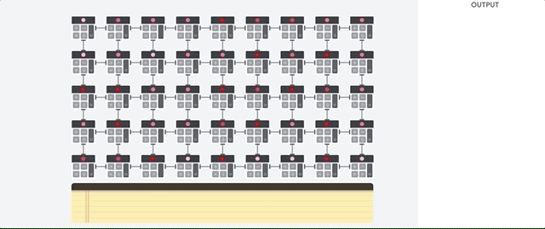
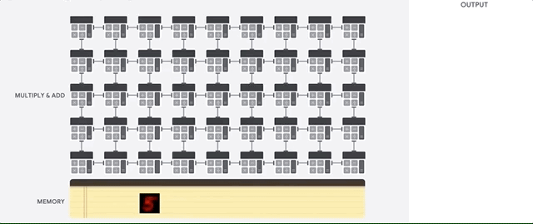
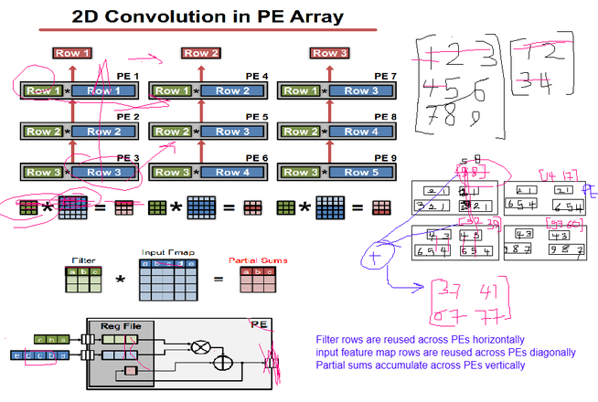
EXTRA NOTES
In the proposed architecture, each data entry is read once and propagate through the different PEs to complete all of its processes. The number of PEs is equal to the number of elements in the output. By the end of the processing, the data only written to the memory once.
This is different than the basic systolic array, where both inputs flow sequentially.
This is also different than the weight stationary, where the number of PEs is equal to the number of weights and each weight stays stationary in the PE.
This is also different from the row stationary architecture.
Page 12

